Slide 1


INTRUSION DETECTION SYSTEMS (IDS)
IMS ENGINEERING COLLEGE, GHAZIABAD
Mr. Ghanshyam Yadav
Assistant Professor
Deptt. of Computer Sciences & Engineering
IMSEC, Ghaziabad, UP
Ghanshyam.yadav@imsec.ac.in
Yadavgh.yam2001@gmail.com
Notes:
1

Slide 2
Agenda
Sources
What is an Intrusion Detection System
Types of Intrusion Detection Systems
How an IDS Works
Detection Methods
Issues
Why are IDS important
How does an IDS fit into your security plan?
Pros and Cons
Questions

Slide 3
What is an Intrusion Detection System?
Defined as the tools, methods, and resources to help identify, assess, and report unauthorized or unapproved network activity.
An IDS detects activity in traffic that may or may not be an intrusion.
IDSes can detect and deal with insider attacks, as well as, external attacks, and are often very useful in detecting violations of corporate security policy and other internal threats.

Slide 4
Host Based Intrusion Detection
Are usually installed on servers and are more focused on analyzing the specific operating systems and applications, resource utilization and other system activity residing on the Host-based IDS host.
It will log any activities it discovers to a secure database and check to see whether the events match any malicious event record listed in the knowledge base.
Host-based IDS are often critical in detecting internal attacks directed towards an organization’s servers such as DNS, Mail, and Web Servers.

Slide 5
Network Based Intrusion Detection
Are dedicated network devices distributed within networks that monitor and inspect network traffic flowing through the device.
Instead of analyzing information that originates and resides on a host, Network-based IDS uses packet sniffing techniques to pull data from TCP/IP packets or other protocols that are traveling along the network.
Most Network-based IDS log their activities and report or alarm on questionable events.
Network-based IDS work best when located on the DMZ, on any subnets containing mission critical servers and just inside the firewall.

Slide 6
Comparison
Host Based
Narrow in scope (watches only specific host activities)
More complex setup
Better for detecting attacks from the inside
More expensive to implement
Detection is based on what any single host can record
Does not see packet headers
Usually only responds after a suspicious log entry has been made
OS-specific
Detects local attacks before they hit the network
Verifies success or failure of attacks
Network Based
Broad in scope (watches all network activities)
Easier setup
Better for detecting attacks from the outside
Less expensive to implement
Detection is based on what can be recorded on the entire network
Examines packet headers
Near real-time response
OS-independent
Detects network attacks as payload is analyzed
Detects unsuccessful attack attempts

Slide 7
Hybrid Intrusion Detection
Are systems that combine both Host-based IDS, which monitors events occurring on the host system and Network-based IDS, which monitors network traffic, functionality on the same security platform.
A Hybrid IDS, can monitor system and application events and verify a file system’s integrity like a Host-based IDS, but only serves to analyze network traffic destined for the device itself.
A Hybrid IDS is often deployed on an organization’s most critical servers.

Slide 8
Honeypots
Are decoy servers or systems setup to gather information regarding an attacker of intruder into networks or systems.
Appear to run vulnerable services and capture vital information as intruders attempt unauthorized access.
Provide you early warning about new attacks and exploitation trends which allow administrators to successfully configure a behavioral based profile and provide correct tuning of network sensors.
Can capture all keystrokes and any files that might have been used in the intrusion attempt.

Slide 9
Passive Systems
Detects a potential security breach
Logs the information
Signals an alert on the console
Does not take any preventive measures to stop the attack

Slide 10
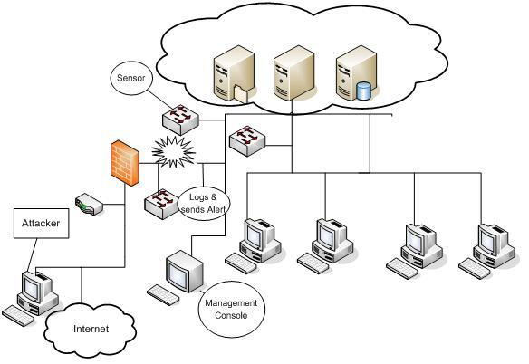
Passive Systems

Slide 11
Reactive/Active Systems
Responds to the suspicious activity like a passive IDS by logging, alerting and recording, but offers the additional ability to take action against the offending traffic.

Slide 12
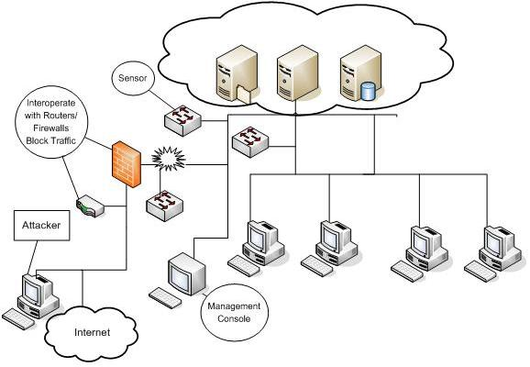
Reactive/Active Systems

Slide 13
Signature Based IDS
Monitor network or server traffic and match bytes or packet sequences against a set of predetermined attack lists or signatures.
Should a particular intrusion or attack session match a signature configured on the IDS, the system alerts administrators or takes other pre-configured action.
Signatures are easy to develop and understand if you know what network behavior you’re trying to identify.
However, because they only detect known attacks, a signature must be created for every attack.
New vulnerabilities and exploits will not be detected until administrators develop new signatures.
Another drawback to signature-based IDS is that they are very large and it can be hard to keep up with the pace of fast moving network traffic.

Slide 14
Anomaly Based IDS
Use network traffic baselines to determine a “normal” state for the network and compare current traffic to that baseline.
Use a type of statistical calculation to determine whether current traffic deviates from “normal” traffic, which is either learned and/or specified by administrators.
If network anomalies occur, the IDS alerts administrators.
A new attack for which a signature doesn’t exist can be detected if it falls out of the “normal” traffic patterns.
High false alarm rates created by inaccurate profiles of “normal” network operations.

Slide 15
Issues
False Negatives
When an IDS fails to detect an attack
False negatives occur when the pattern of traffic is not identified in the signature database, such as new attack patterns.
False negatives are deceptive because you usually have no way of knowing if and when they occurred.
You are most likely to identify false negatives when an attack is successful and wasn’t detected by the IDS.
False Positives
Described as a false alarm.
When an IDS mistakenly reports certain “normal” network activity as malicious.
Administrators have to fine tune the signatures or heuristics in order to prevent this type of problem.

Slide 16
Why are IDS important?
The ability to know when an intruder or attacker is engaged in reconnaissance or other malicious activity can mean the difference between being compromised and not being compromised.
An IDS can alert the administrator of a successful compromise, allowing them the opportunity to implement mitigating actions before further damage is caused
As Corporations and other Institutions are being legally compelled to disclose data breaches and compromises to their affected customers, this can have profound effects upon a compromised company, in the way of bad press, loss of customer trust, and the effects on their stock.

Slide 17
How does it fit into your security plan?
As a network security expert you should know you cannot just rely on one or a few tools to secure your network. You need to have a defense in depth mindset and layer your network defenses.
Through the use of inside and outside firewalls, DMZs, Routers and Switches, an IDS is a great addition to your security plan.
You can use them to identify vulnerabilities and weaknesses in your perimeter protection devices, such as: firewalls, switches and routers. The firewall rules and router access control lists can be verified regularly for compliance.
You can use IDSes to enforce security policies, such as: unauthorized Internet access, downloads of executable files, use of file sharing programs like Kazza, or Instant Messenger use.
IDSes are also an invaluable source of evidence. Logs from an IDS can become an important part of computer forensics and incident handling efforts.

Slide 18
Pros
Can detect external hackers, as well as, internal network-based attacks
Scales easily to provide protection for the entire network
Offers centralized management for correlation of distributed attacks
Provides defense in depth
Gives administrators the ability to quantify attacks
Provides an additional layer of protection

Slide 19
Cons
Generates false positives and negatives
Reacts to attacks rather than preventing them
Requires full-time monitoring and highly skilled staff dedicated to interpreting the data
Requires a complex incident response process
Cannot monitor traffic at higher network traffic rates
Generates an enormous amount of data to be analyzed
Cannot deal with encrypted network traffic
It is expensive

